Slide 2
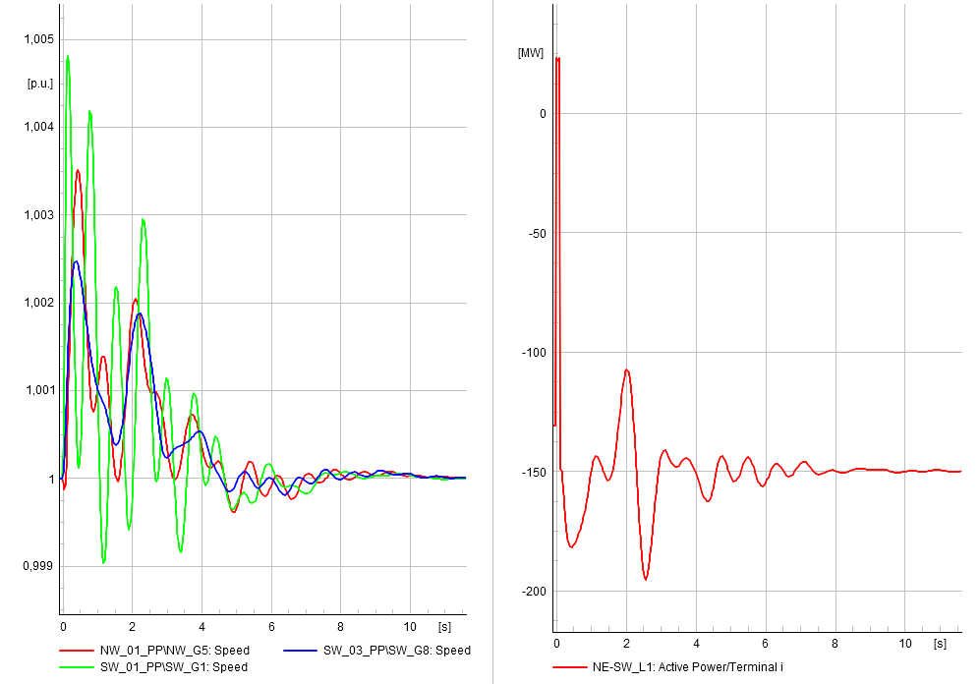
Transmission System
Mert Karacelebi – 03.10.2022
Notes:
Source https://www.bioenergyconsult.com/impact-of-machine-learning-on-renewable-energy/

Slide 3
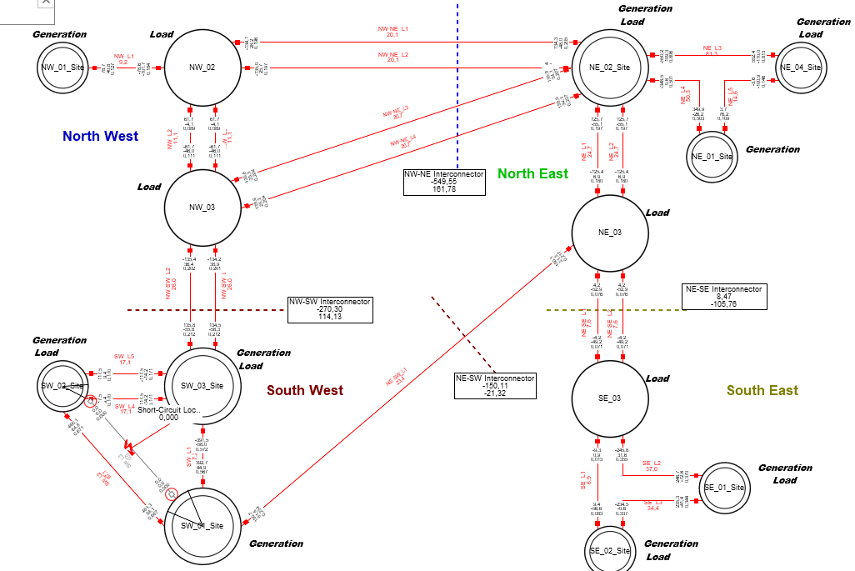
System Overview
50 Hz System, European system, 400kV high voltage system.
4 regions are connected with long transmission corridors.
Loads are constant P,Q.
AVR, PSS, governors, and turbine dynamics are included (same for each).
Type C PV and type 3 wind turbines.

Slide 4
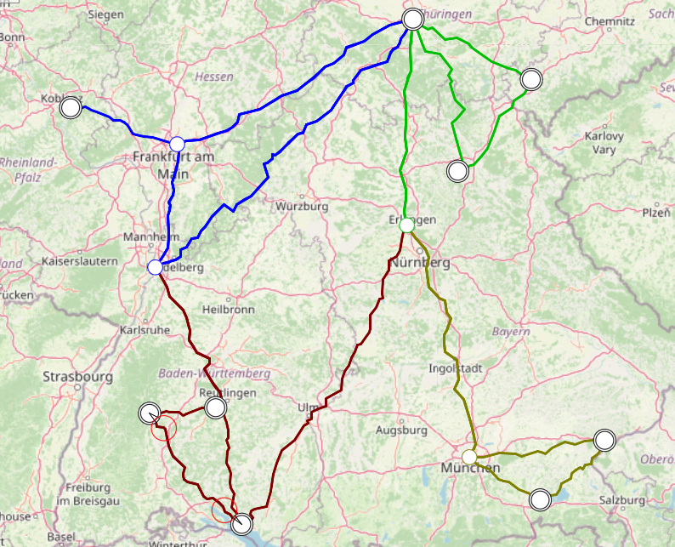
Map
Regions are modeled with simple transmission networks.

Slide 5
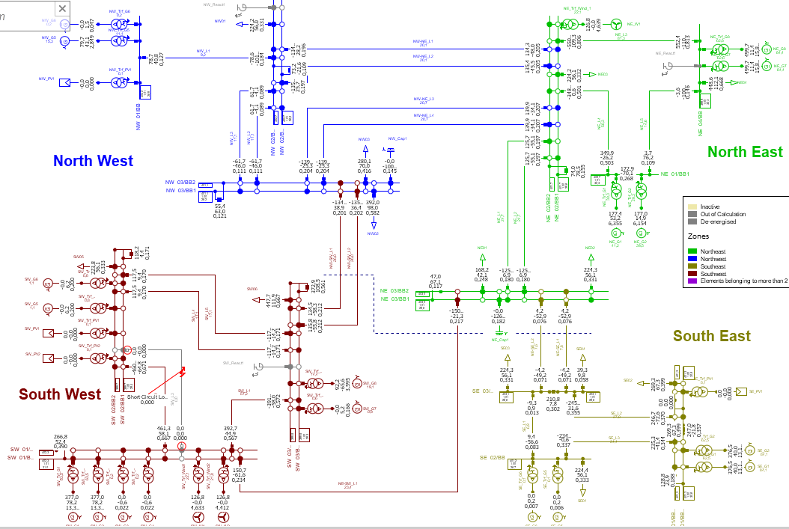
Single line diagram
13 main buses with coupling option.
18 dispatchable generation.
7 VRES
13 loads

Slide 6
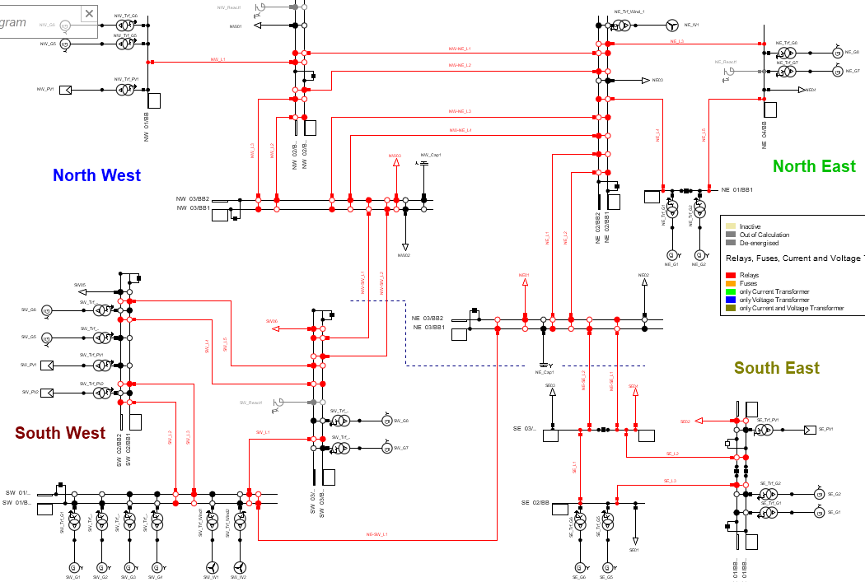
Protection System
Red lines contain relays.
Distance protection (R/X).
Controller protection systems are modeled as well.
Only overcurrent protection is valid for lines.
The frequency protection of generators is missing.
Frequency and voltage protection of PV units are available.

Slide 7
Profiles

Slide 8
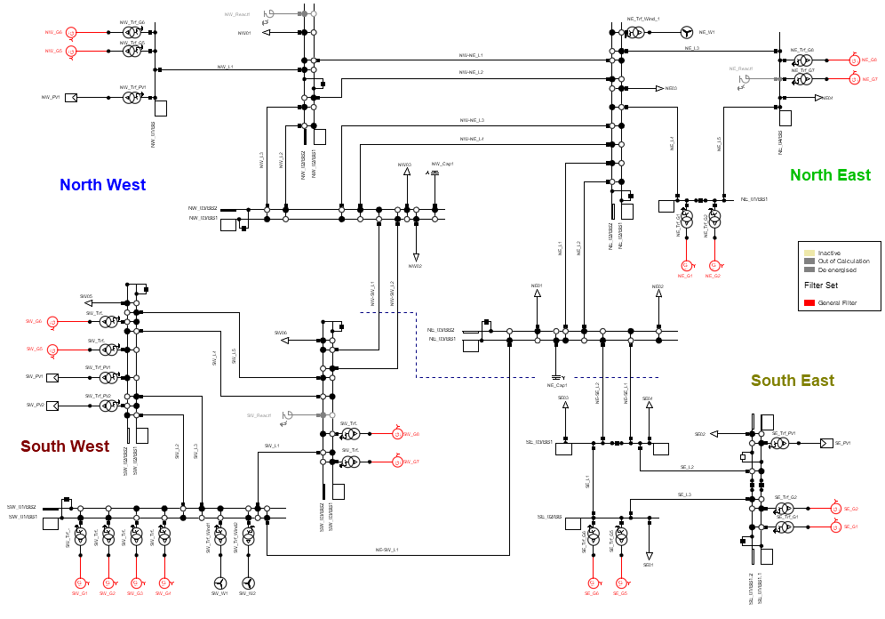

Selected Gens
SW-G8 (reference machine)
SW-G1
SE-G6
NE-G2
NW-G5 (Profile is stable)
Monitored variables:
[$δ, ω, P_{G}, Q_{G}, V_{T}$]
[Rotor angle, rotor speed, active power generation, reactive power generation, voltage magnitude]

Slide 9


DSA Limits
$$δ$$
Insecure
Definition: Remain in a normal state after a single likely contingency.
Insecure if goes to alert state.
Conventional DSA considers each contingency case offline setup.
Contingencies are selected from expert knowledge BUT even small contingencies might lead to insecure conditions.
The biggest problem is the determination of the disturbance since it is highly unpredictable.
Inertial stability criteria & Minimum damping: Machine angle and frequency evaluation, asynchronism detection.
Solution: Check oscillations from NODE predictions, and check frequency deviation/convergence. If convergence is not achieved, label it as insecure.
Secure
$$ω$$
Insecure
Secure
Insecure

Slide 10


DSA Limits
Definition: Remain in a normal state after a single likely contingency.
Insecure if goes to alert state.
Conventional DSA considers each contingency case offline setup.
Contingencies are selected from expert knowledge BUT even small contingencies might lead to insecure conditions.
The biggest problem is the determination of the disturbance since it is highly unpredictable.
Inertial stability criteria & Minimum damping: Machine angle and frequency evaluation, asynchronism detection.
Voltage excursions: Voltage excursion threshold/duration pairs.
Solution: Based on these limits check violations.
$$t$$
$$V$$
Insecure
Secure

Slide 11
DSA Limits
Definition: Remain in a normal state after a single likely contingency.
Insecure if goes to alert state.
Conventional DSA considers each contingency case offline setup.
Contingencies are selected from expert knowledge BUT even small contingencies might lead to insecure conditions.
The biggest problem is the determination of the disturbance since it is highly unpredictable.
Inertial stability criteria & Minimum damping: Machine angle and frequency evaluation, asynchronism detection.
Voltage excursions: Voltage excursion threshold/duration pairs.
Relay margin criteria: Relay margin violations.
Solution: Frequency protection relay limits (RoCoF), check the maximum generated power.

Slide 12
DSA Limits
Remaining issues and limitations:
First swing instability, is not possible to learn and predict.
Constant changes in the network properties, if cascades are fast, might lead to unpredictable event sequences.
Insecurity comes from other elements in the network, and the number of predictors might be increased.
Determination of security limits, system operators might not be acknowledged the actual system limits hence false predictions.
In determining event severity, our method does not evaluate how severe is the experienced event. The indication might be useful when it is time critical.

Slide 13
Disturbances
3-phase fault: fault locations and impedance.
Line locations (in the middle of the line): NE-SW_L1 (SC1), NW-NE_L3 (SC2), NW_L3 (SC3), NW-SW_L2 (SC4), NE-SE_L1 (SC5), NE_L2 (SC6)
Bus locations: SW_L2 (SC7), NW_03/BB2 (SC8), SE_L3 (SC9), SE_03/BB1 (SC10)
Impedance: 0+0j, 0.1+0.1j, 1+0.1j, 0.1+1j, 1+1j, 10+1j, 5+0.5j , 10+10j, 100+0j, 0+100j, 200+200j.

Slide 14
Disturbances
3-phase fault: fault locations and impedance.
Line locations (in the middle of the line): NE-SW_L1 (SC1), NW-NE_L3 (SC2), NW_L3 (SC3), NW-SW_L2 (SC4), NE-SE_L1 (SC5), NE_L2 (SC6)
Bus locations: SW_L2 (SC7), NW_03/BB2 (SC8), SE_L3 (SC9), SE_03/BB1 (SC10)
Impedance: 0+0j, 0.1+0.1j, 1+0.1j, 0.1+1j, 1+1j, 10+1j, 5+0.5j , 10+10j, 100+0j, 0+100j, 200+200j.
Red examples are selected as initial cases: sample from yearly data, select a day from each season for each fault case (6 cases total). Without a replacement for better representation.
One day from the rest of the distribution and if all four days are weekdays sample from the weekend. If one of them is a weekend sample from a weekday.
5 days for each fault and test 4 impedances for all hours. #SIM_per_fault = 5*24*4=480 simulations
In total: #SIM=6*480= 2880 simulations. (SIM_file_1)
Final number of simulations with reduced fault cases: 720*6=4320 (SIM_file_2=[SIM_file_1+SIM_2])
Final number of simulations: 720*10=7200 (SIM_file_3=[SIM_file_2+SIM_3)

Slide 15
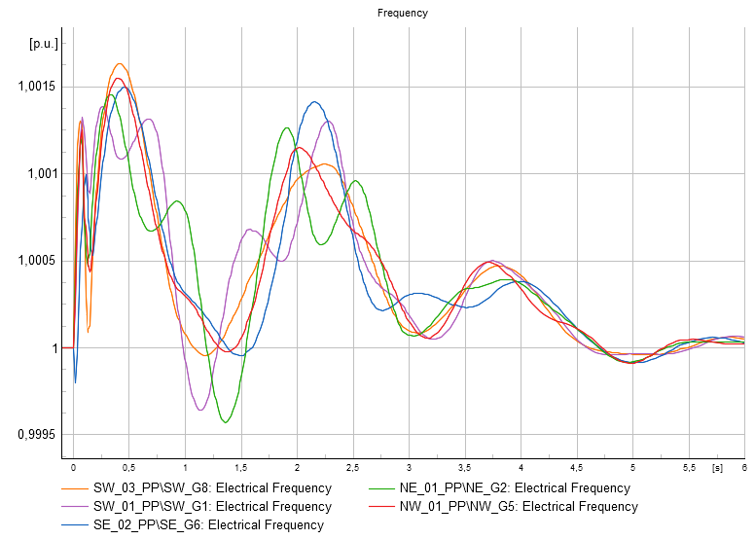
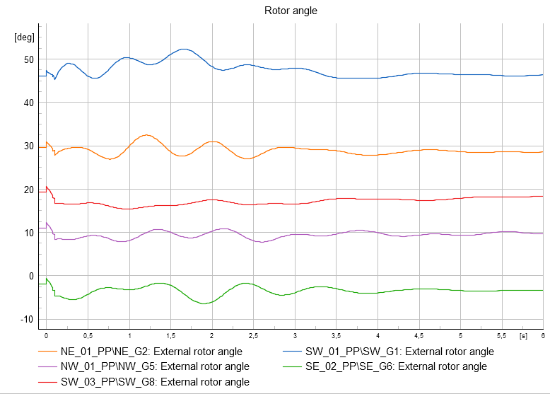
Impedance analysis
SC1- 0+0j

Slide 16
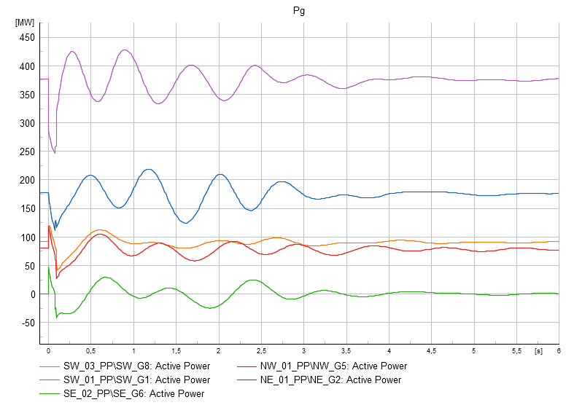
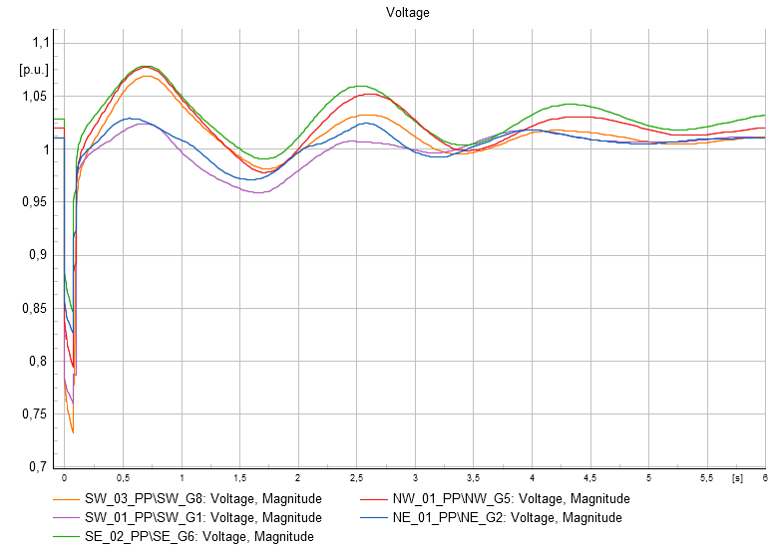
Impedance analysis
SC1- 0+0j

Slide 17
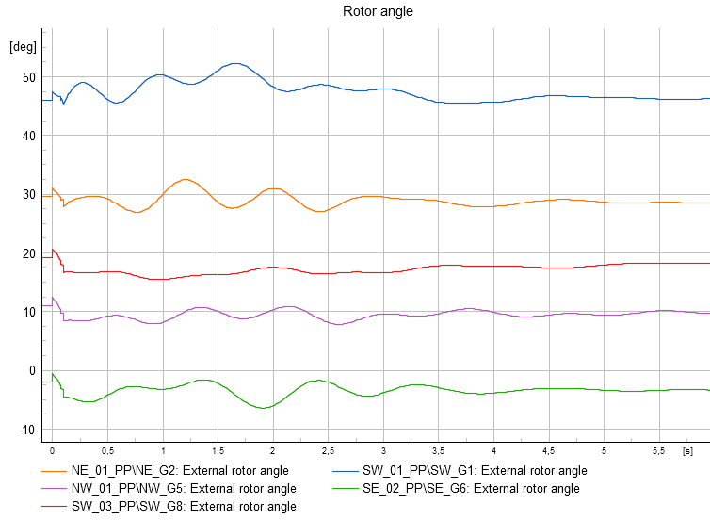
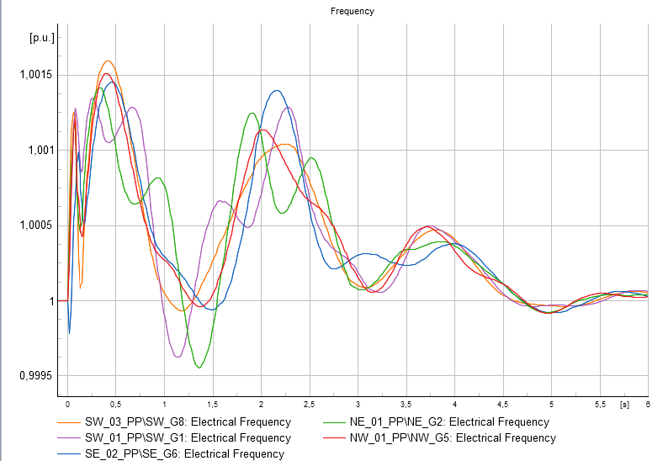
Impedance analysis
SC1- 0.1+0.1j

Slide 18
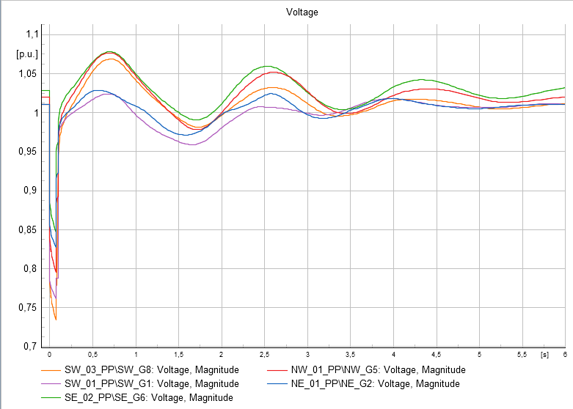
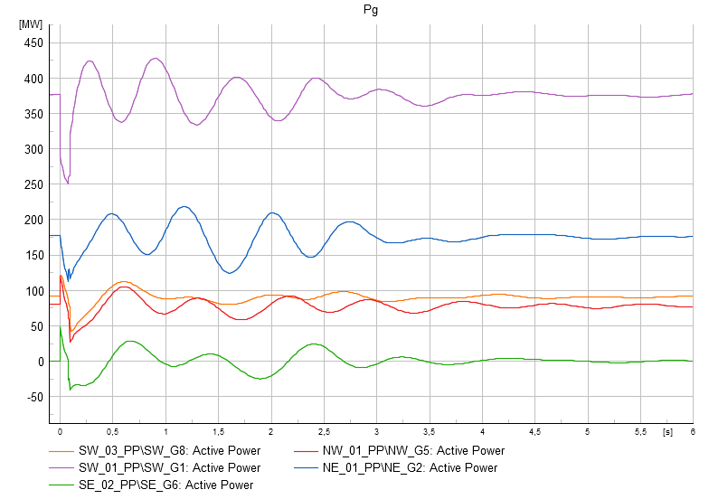
Impedance analysis
SC1- 0.1+0.1j
Identical with the first impedance so omit.

Slide 19
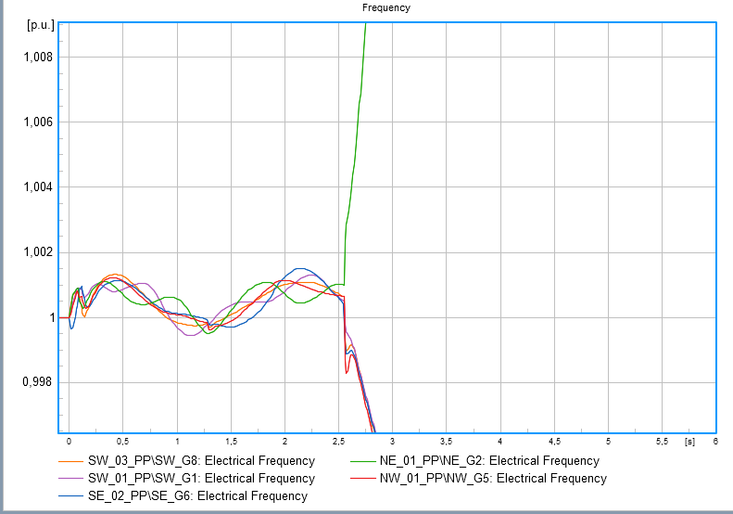
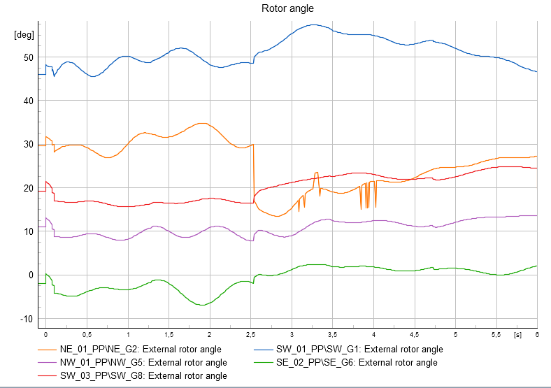
Impedance analysis
SC1- 1+0.1j

Slide 20
Impedance analysis
SC1- 1+0.1j – System split and load shedding happened.

Slide 21
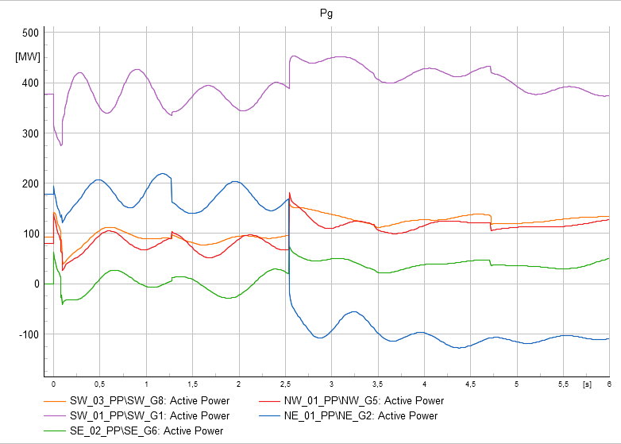
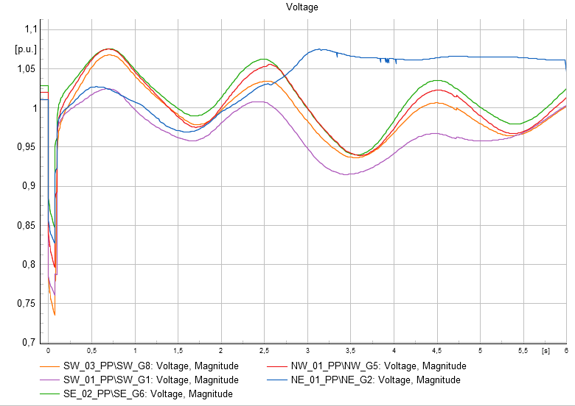
Impedance analysis
SC1- 1+0.1j – Good plot will be covered in analysis

Slide 22
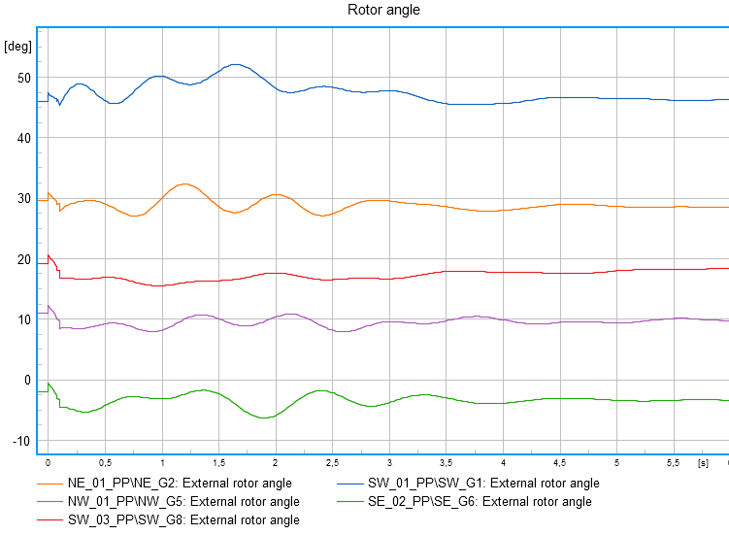
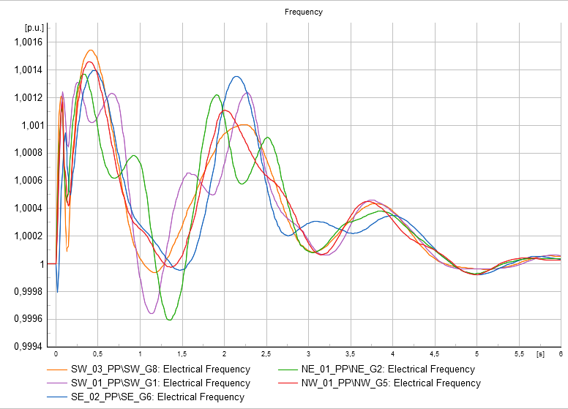
Impedance analysis
SC1- 0.1+1j

Slide 23
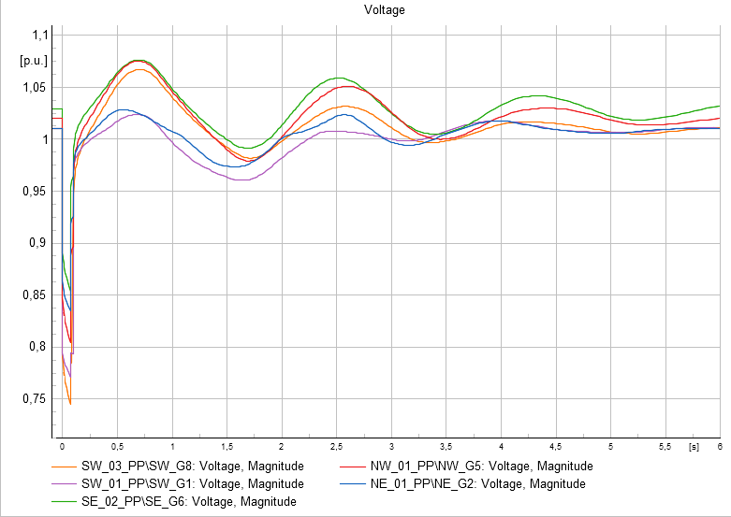
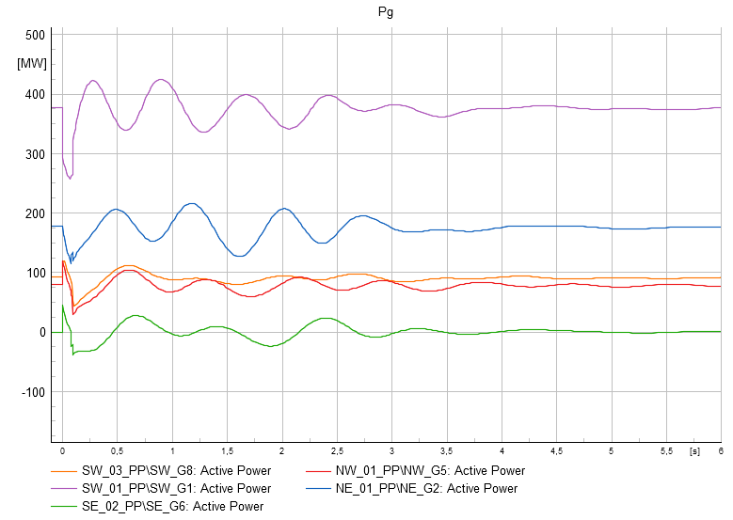
Impedance analysis
SC1- 0.1+1j – Same response, discarded from the analysis.

Slide 24
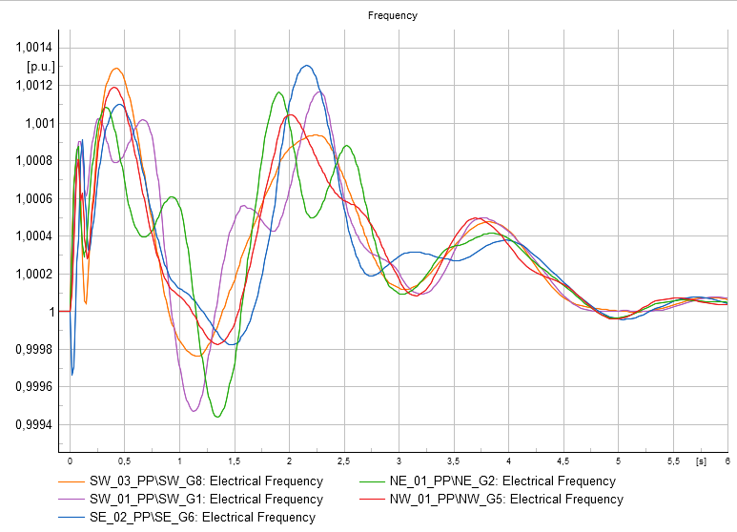
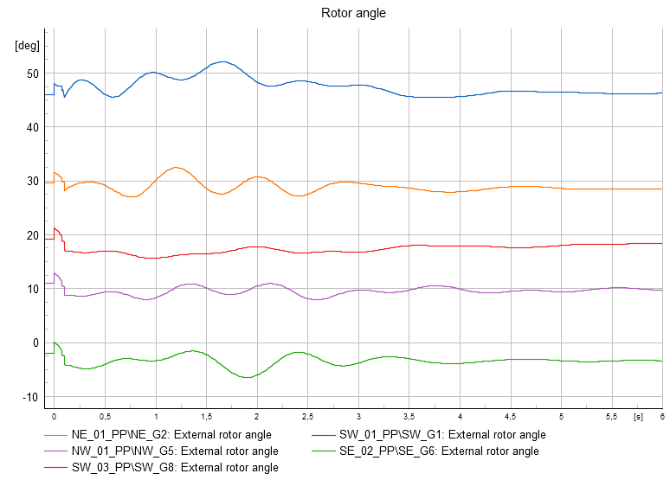
Impedance analysis
SC1- 1+1j

Slide 25
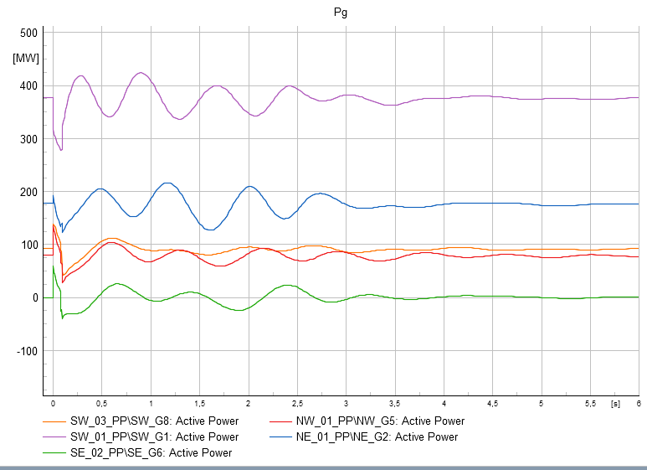
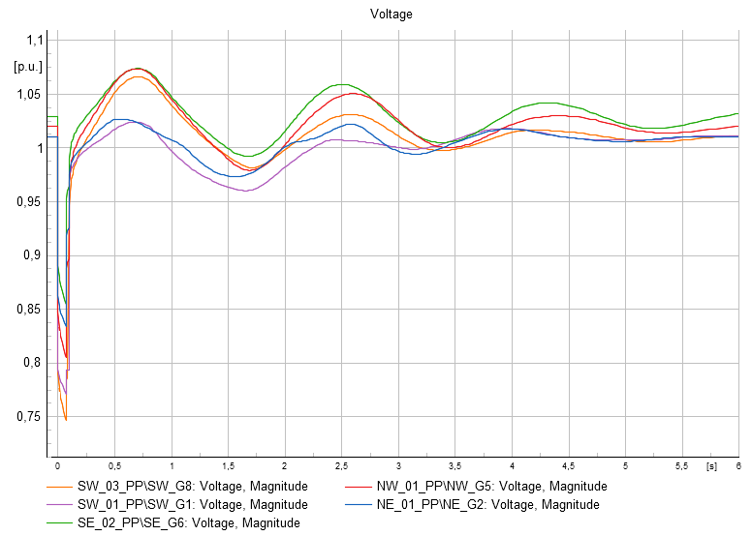
Impedance analysis
SC1- 1+1j – Identical with 0+0j case.

Slide 26
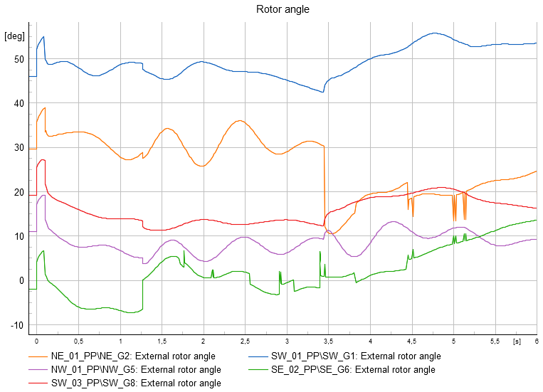
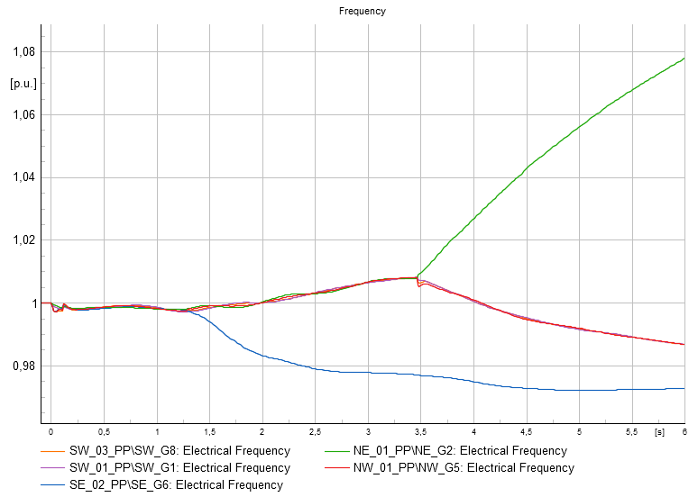
Impedance analysis
SC1- 10+1j

Slide 27
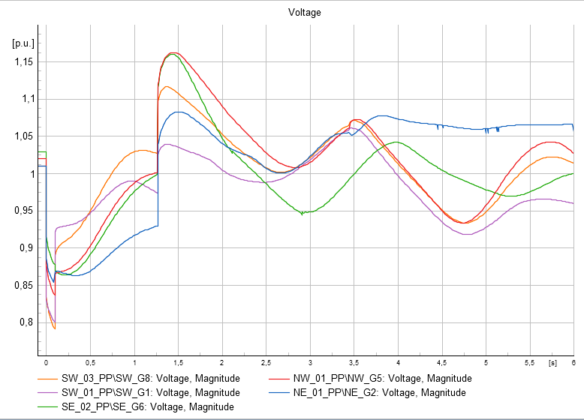
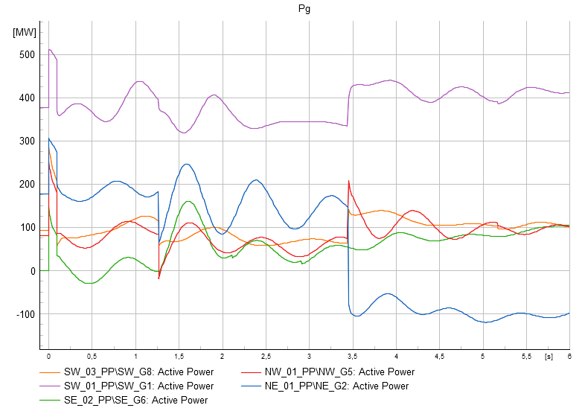
Impedance analysis
SC1- 10+1j – Double system split, nice case included.

Slide 28
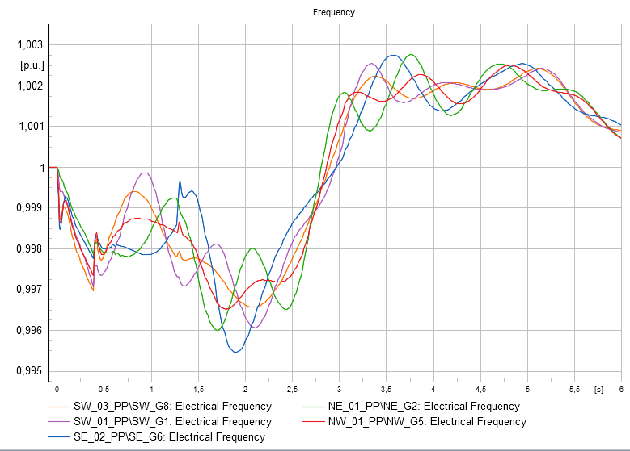
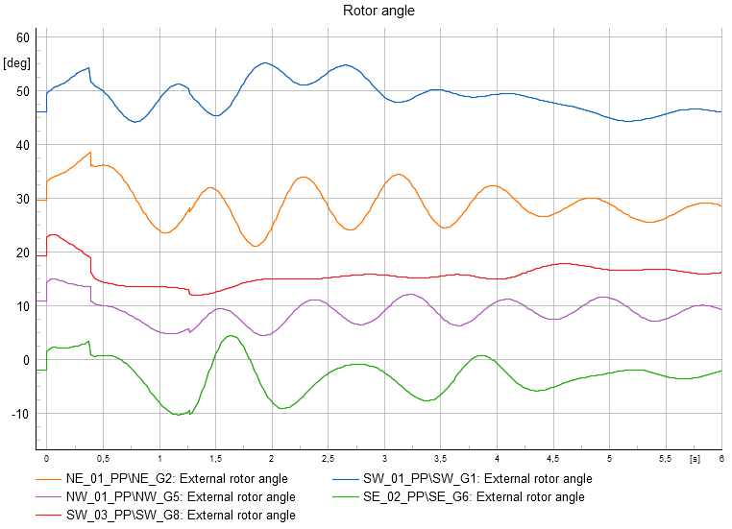
Impedance analysis
SC1- 10+10j.

Slide 29
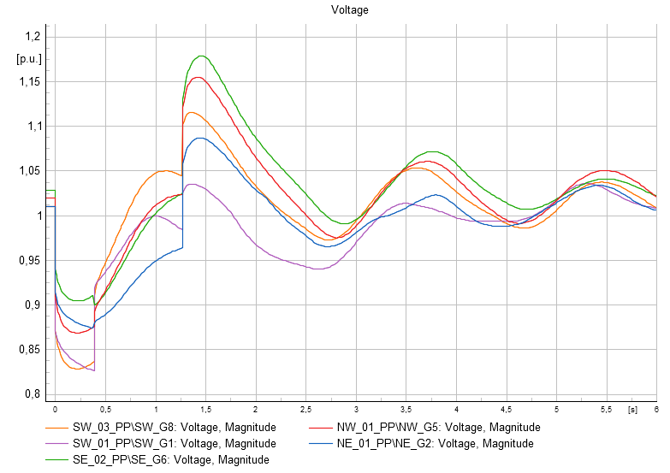
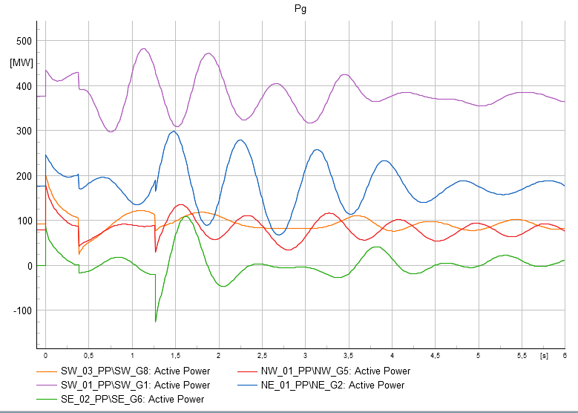
Impedance analysis
SC1- 10+10j – New voltage phenomena, included in the analysis.

Slide 30
Impedance analysis
SC1- 10+10j – New voltage phenomena, included in the analysis.

Slide 31
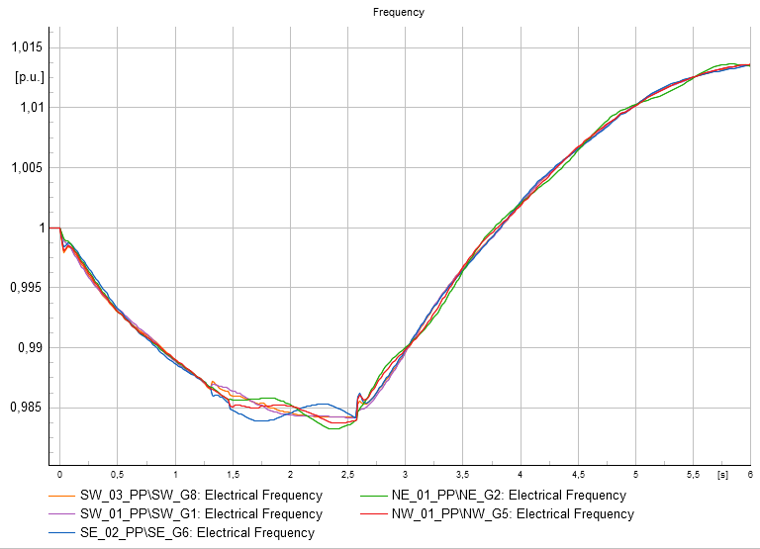
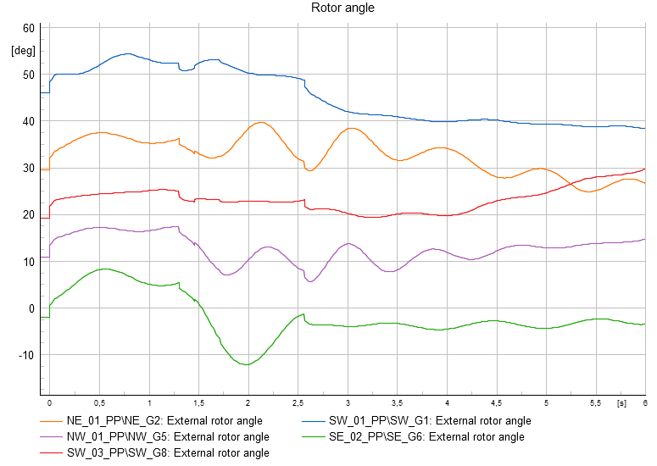
Impedance analysis
SC1- 100+0j

Slide 32
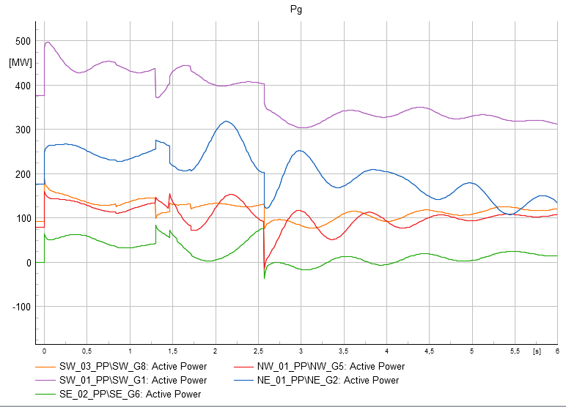
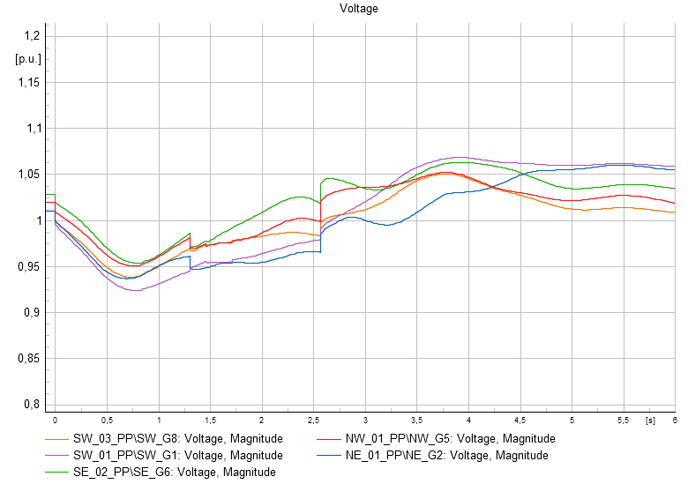
Impedance analysis
SC1- 100+0j – Undetected fault, interesting.

Slide 33
Impedance analysis
SC1- 100+0j – Included.

Slide 34
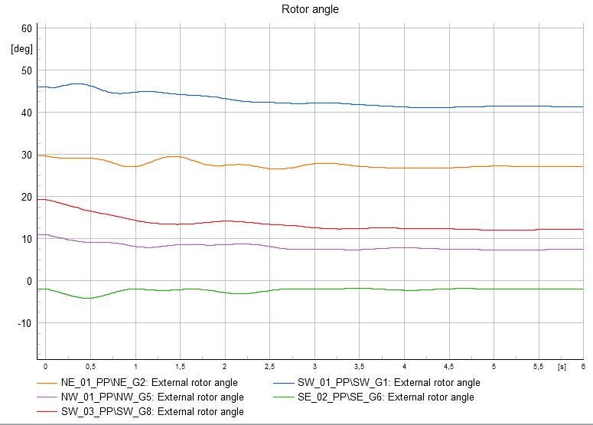
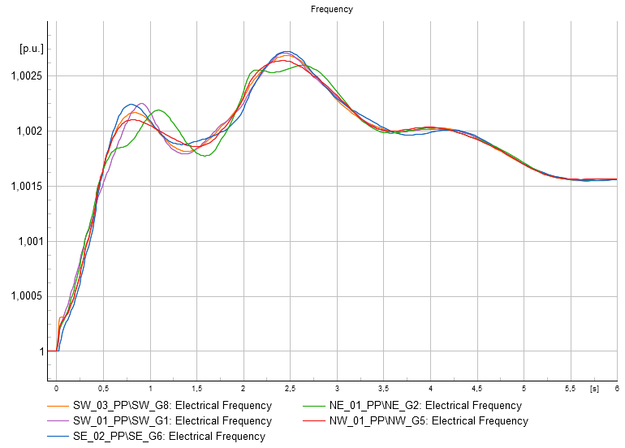
Impedance analysis
SC1- 0+100j – Fault is never detected.

Slide 35
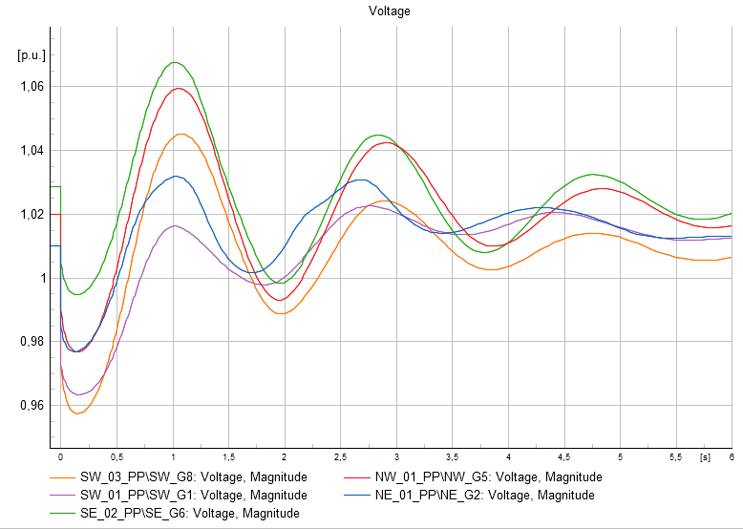
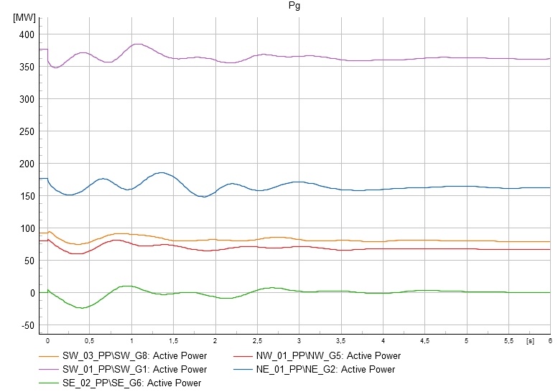
Impedance analysis
SC1- 0+100j – Fault is never detected.

Slide 36
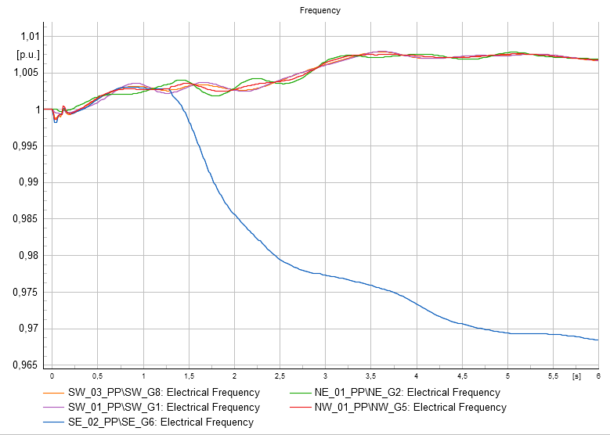
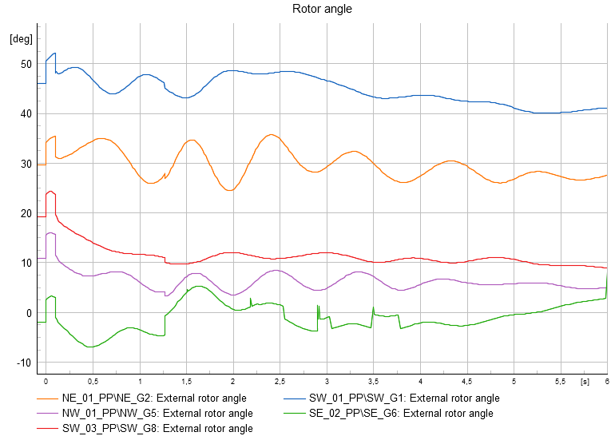
Impedance analysis
SC1- 5+0.5j

Slide 37
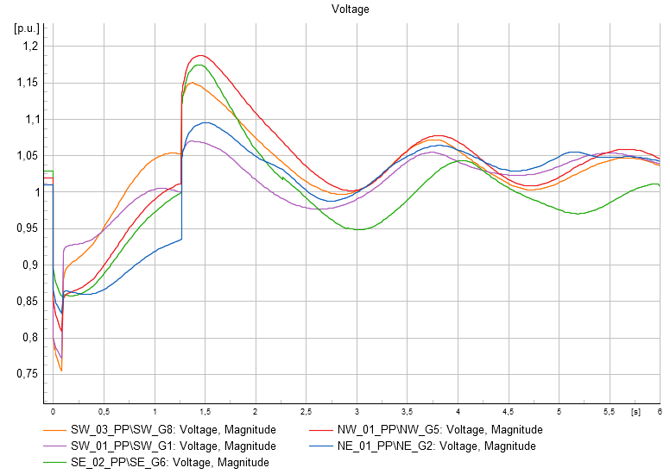
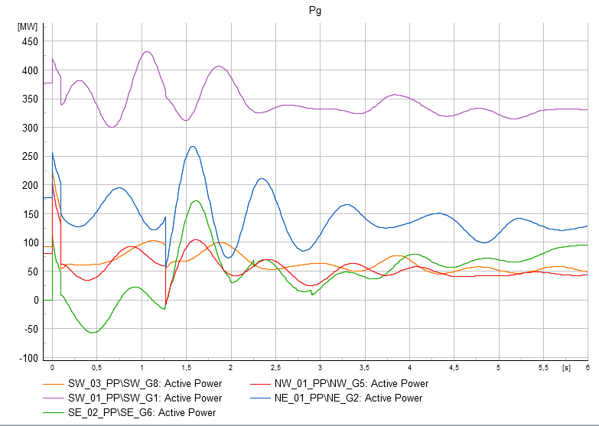
Impedance analysis
SC1- 5+0.5j

Slide 38
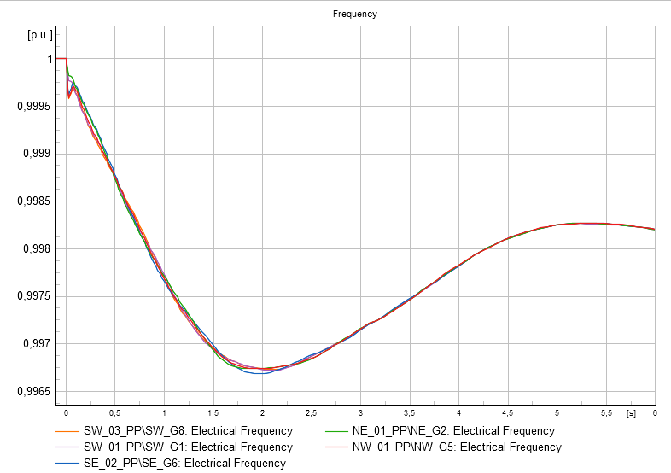
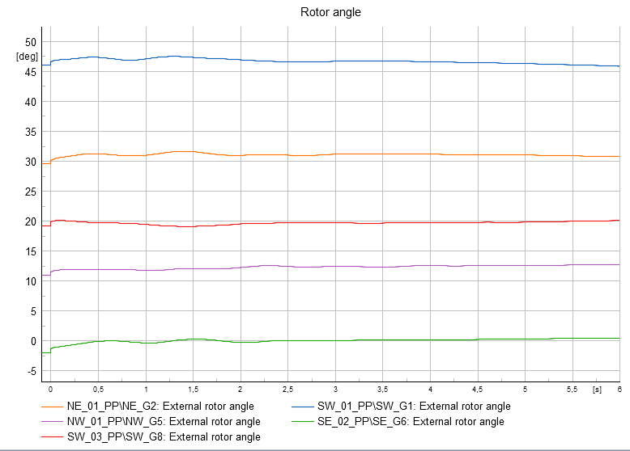
Impedance analysis
SC1- 200+200j

Slide 39
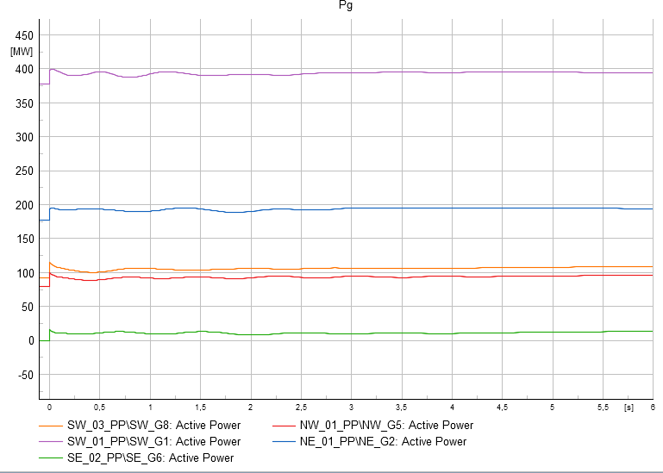

Impedance analysis
SC1- 200+200j

Slide 40
Example Cascade
(t=-100:000 ms) Initial conditions calculated.evt -
(t=000:000 ms) South West\NE-SW_L1.ElmLne:Short-circuit with Fault Impedance Rf = 10,000000 Ohm Xf = 1,000000 Ohm. Fault Location: 50,0000 % from 'North East\NE_03\BB1.ElmTerm'evt -
(t=035:000 ms) Relay is tripping. 'Open' signal is sent to the connected breaker(s).evt - (t=035:000 ms) South West\SW_01_Site\SW_01\CB6.ElmCoup: Circuit-Breaker Action: 'Open' - 'All phases'.info –
(t=095:000 ms) Element ' SW_G8' is local reference in separated area of ' SW_Term_G8'info - (t=095:000 ms) Element ' SW_G8' is reference in 50,0 Hz-systemevt -
(t=01:206 s) North East\NE_04_Site\NE_04\1\Cub_1\Dist_NE_04-NE_02.ElmRelay: Relay is tripping. 'Open' signal is sent to the connected breaker(s).evt - (t=01:206 s) North East\NE_03\5\Cub_1\Dist_NE_03-SW_01.ElmRelay: Relay is tripping. 'Open' signal is sent to the connected breaker(s).evt - (t=01:206 s) North East\NE_04_Site\NE_04\CB1.ElmCoup: Circuit-Breaker Action: 'Open' - 'All phases'.evt - (t=01:206 s) North East\NE_03\CB5.ElmCoup: Circuit-Breaker Action: 'Open' - 'All phases'.evt - (t=01:206 s) North East\NE_02_Site\NE_02\1\Cub_1\Dist_NE_02-NE_03_1.ElmRelay: Relay is tripping. 'Open' signal is sent to the connected breaker(s).evt - (t=01:206 s) North East\NE_02_Site\NE_02\2\Cub_1\Dist_NE_02-NE_03_2.ElmRelay: Relay is tripping. 'Open' signal is sent to the connected breaker(s).evt - (t=01:206 s) North East\NE_02_Site\NE_02\CB2.ElmCoup: Circuit-Breaker Action: 'Open' - 'All phases'.evt - (t=01:206 s) North East\NE_02_Site\NE_02\CB1.ElmCoup: Circuit-Breaker Action: 'Open' - 'All phases'.info –
(t=01:266 s) Element ' SW_G8' is local reference in separated area of ' SW_Term_G8'info - (t=01:266 s) Element ' SE_G5' is local reference in separated area of ' SE_Term_G5'info - (t=01:266 s) Grid split into 2 isolated areasinfo - (t=01:266 s) Element ' SW_G8' is reference in 50,0 Hz-systemevt - (t=01:806 s) South East\SE_01_Site\SE_01\R4\Cub_1\Relay Model SEB2.ElmRelay: Frequency Relay (Step: '1 Logic') - is tripping.evt - (t=01:806 s) North East\NE_03\7\Cub_1\Relay Model NEA4.ElmRelay: Frequency Relay (Step: '1 Logic') - is tripping.evt -
(t=01:806 s) South East\SE_03\R4\Cub_1\Relay Model SED2.ElmRelay: Frequency Relay (Step: '1 Logic') - is tripping.evt -

Slide 41
Example cascade
(t=01:856 s) North East\NE_03\NE01.ElmLod: Load Event: 'Incremental Change' - Active Power changed by -7,500 %. Reactive Power changed by -7,500 %.evt - (t=01:856 s) South East\SE_03\SE04.ElmLod: Load Event: 'Incremental Change' - Active Power changed by -5,000 %. Reactive Power changed by -5,000 %.evt - (t=01:856 s) South East\SE_01_Site\SE_01\SE02.ElmLod: Load Event: 'Incremental Change' - Active Power changed by -5,000 %. Reactive Power changed by -5,000 %.evt - (t=02:066 s) North East\NE_03\7\Cub_1\Relay Model NEA4.ElmRelay: Frequency Relay (Step: '2 Logic') - is tripping.evt - (t=02:076 s) South East\SE_03\R4\Cub_1\Relay Model SED2.ElmRelay: Frequency Relay (Step: '2 Logic') - is tripping.evt - (t=02:096 s) South East\SE_01_Site\SE_01\R4\Cub_1\Relay Model SEB2.ElmRelay: Frequency Relay (Step: '2 Logic') - is tripping.evt - (t=02:116 s) North East\NE_03\NE01.ElmLod: Load Event: 'Incremental Change' - Active Power changed by -20,000 %. Reactive Power changed by -20,000 %.evt - (t=02:126 s) South East\SE_03\SE04.ElmLod: Load Event: 'Incremental Change' - Active Power changed by -5,000 %. Reactive Power changed by -5,000 %.evt - (t=02:146 s) South East\SE_01_Site\SE_01\SE02.ElmLod: Load Event: 'Incremental Change' - Active Power changed by -5,000 %. Reactive Power changed by -5,000 %.evt - (t=02:861 s) North East\NE_03\7\Cub_1\Relay Model NEA4.ElmRelay: Frequency Relay (Step: '3 Logic') - is tripping.evt - (t=02:876 s) South East\SE_01_Site\SE_01\R4\Cub_1\Relay Model SEB2.ElmRelay: Frequency Relay (Step: '3 Logic') - is tripping.evt - (t=02:876 s) South East\SE_03\R4\Cub_1\Relay Model SED2.ElmRelay: Frequency Relay (Step: '3 Logic') - is tripping.evt - (t=02:911 s) North East\NE_03\NE01.ElmLod: Load Event: 'Incremental Change' - Active Power changed by -20,000 %. Reactive Power changed by -20,000 %.evt - (t=02:926 s) South East\SE_03\SE04.ElmLod: Load Event: 'Incremental Change' - Active Power changed by -5,000 %. Reactive Power changed by -5,000 %.evt - (t=02:926 s) South East\SE_01_Site\SE_01\SE02.ElmLod: Load Event: 'Incremental Change' - Active Power changed by -5,000 %. Reactive Power changed by -5,000 %.evt - (t=03:391 s) North East\NE_01_Site\NE_01\L3\Cub_1\Dist_NE_01-NE_02.ElmRelay: Relay is tripping. 'Open' signal is sent to the connected breaker(s).evt - (t=03:391 s) North East\NE_01_Site\NE_01\CB.L3.ElmCoup: Circuit-Breaker Action: 'Open' - 'All phases'.info - (t=03:451 s) Element ' NE_G7' is local reference in separated area of ' NE_Term_G7'info - (t=03:451 s) Element ' SW_G8' is local reference in separated area of ' SW_Term_G8'info - (t=03:451 s) Element ' SE_G5' is local reference in separated area of ' SE_Term_G5'info - (t=03:451 s) Grid split into 3 isolated areasinfo - (t=03:451 s) Element ' SW_G8' is reference in 50,0 Hz-systemevt - (t=05:113 s) South West\SW_03_Site\SW_03\7\Cub_1\Relay Model SWD1.ElmRelay: Frequency Relay (Step: '1 Logic') - is tripping.evt - (t=05:123 s) North West\NW_03\8\Cub_1\Relay Model NWB4.ElmRelay: Frequency Relay (Step: '1 Logic') - is tripping.evt - (t=05:163 s) South West\SW_03_Site\SW_03\SW06.ElmLod: Load Event: 'Incremental Change' - Active Power changed by -10,000 %. Reactive Power changed by -10,000 %.evt - (t=05:173 s) North West\NW_03\NW03.ElmLod: Load Event: 'Incremental Change' - Active Power changed by -7,500 %. Reactive Power changed by -7,500 %.info - (t=01:00:00 min) Simulation successfully executed.info - (t=01:40:00 min) Simulation successfully executed.info -

Slide 42
Approach
Vary Zf in relay lines from 0 ohm, 0.1ohm, 0.5 ohm, 1 ohm, 10 ohm, 100ohm.
Select Locations, based on the impact.

Slide 43
How to find representative cases?
Use base case scenario
Define DSA in python
Run 3 phase faults at each bus with fixed Zf=1+j1 but varying fault duration [125ms, 150ms, 175ms, 200ms, 250ms]
Record DSA results
Based on DSA results identify points to experiment further.
Change the loading level and dispatch scenarios with these examples.
At the end we can alternate the fault impedance for small number of cases.

